Slide 1
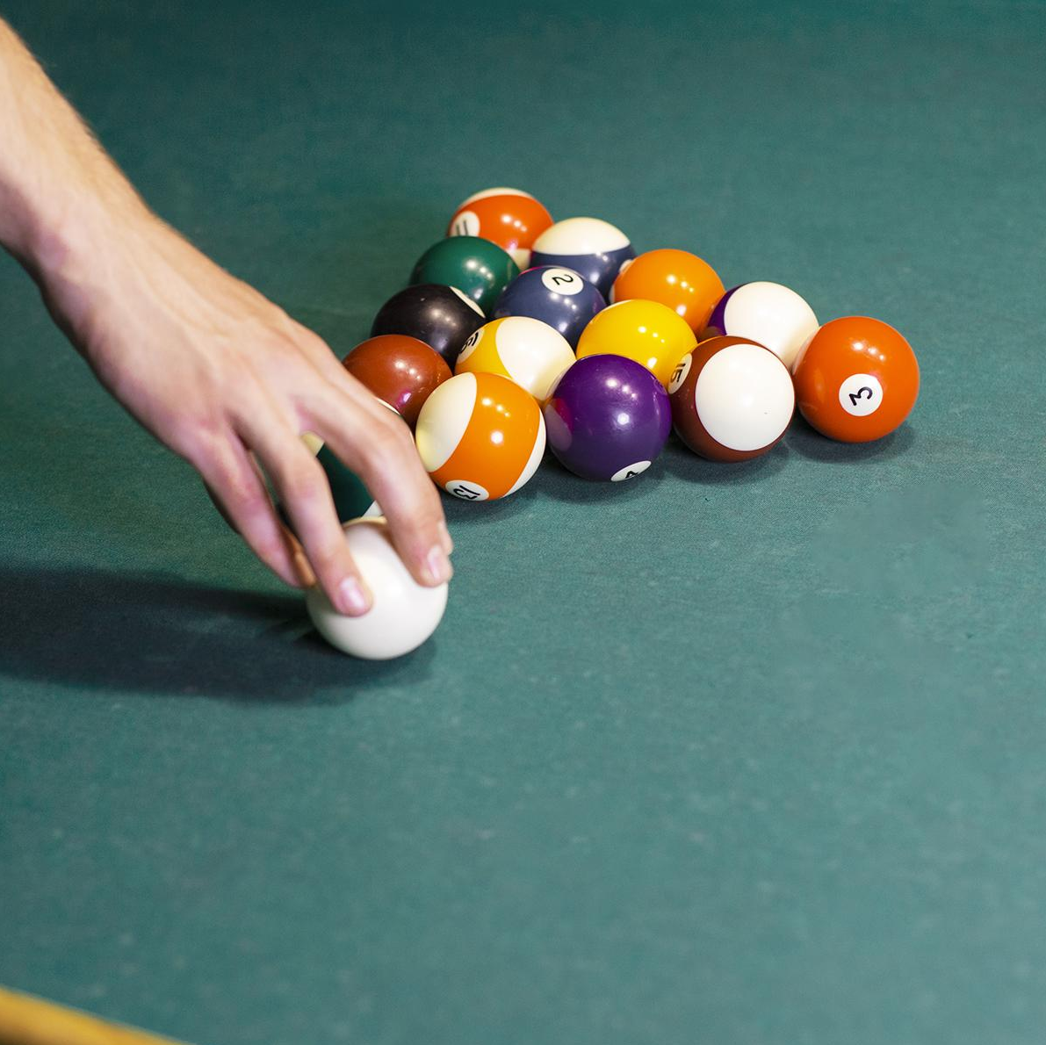
POOl Game C174C
Avalon Vinella, Mohsen Fayyaz,
Haniyeh Ehsani Oskouie, Benet Oriol Sabat

Slide 2
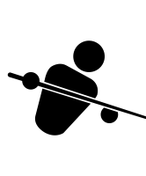
Description
The pool game:
The user defines the direction and velocity of the first shot
The articulated hand hits the ball using the cue
The balls move and collide realistically

Slide 3
Algorithms
Particle Simulation
Collisions
Splines
Articulated kinematics
Simulation of the balls' dynamics
(x(t), v(t), friction, …)
Collision Detection & Collision Resolution
The cue moves toward the ball according to a parametric curve
A human arm moves the cue according to inverse kinematics

Slide 4

Current Progress

Slide 5
Stretch Goals
Character Animation
Move around the table
  Floating torso
  Walk along spline
Celebration animation
  Move hands along a spline, use IK to animate arms
Ball Visuals
Textures (ex. numbered balls)
Impact effects
  Fire, explosions, etc.

Slide 6
THANKS!
Do you have any questions?
CREDITS: This presentation template was created by Slidesgo, including icons by Flaticon, infographics & images by Freepik

Slide 7
Creativity
?

Slide 8
Tasks
Keyboard (quick+fine grained) + indicator [Avalon] ✅
Good looking table [Haniyeh]✅
  Init balls position [Hanieyh] ✅
Inverse Kinematics (separate cue) [Mohsen] ✅
Rotate the balls with velocity [Benet] ✅
Textured Balls [Benet] ✅
Hole Detection and going down (explode) ✅
Good looking Human Model
Friction [Benet] ✅
Moving the human
Setting the ball on fire
Celebration
Textures
Game dynamics (start, reset, random ball, triangle position, ¿points?…)

Slide 9
Little optional tasks
Scale up the strength of the white ball (default before increasing arrow should be stronger)
The white ball should appear again after fallen into the whole
the cue follows a more complex spline when hitting the ball (simply along the long axis but something slightly more realistic)
Making the left hand reach the top of the cue (might not need inverse kinematics)

Slide 10
Ball collisions
Collision of two balls can be detected if the distance between the centers is smaller than the sum of their radius.
Collision resolution is a perfect elastic collision [1].
We define collision direction as the vector between the two balls at the moment of direction.
Velocity components normal to the collision direction remain unchanged.
Velocity components parallel to the collision direction are swapped between the two balls (assuming same-mass balls).
[1] https://en.wikipedia.org/wiki/Elastic_collision#Two-dimensional_collision_with_two_moving_objects

Slide 11
Friction.
We model friction as a constant force in the direction opposite to the velocity.

